Slide 1
Online GPS II/MAPP
Meetings 1 – 10

Slide 2
Meeting 1 Welcome to GPS II/MAPP Program

Slide 3
License Rights to OCFS
Center for Development of Human Services, Institute for Community Health Promotion, SUNY Buffalo State acknowledges the State of New York’s and the Office of Children and Family Services’ royalty-free, non-exclusive and revocable license to reproduce, publish, distribute, or otherwise use any and all material herein for the limited purpose of training GPSII/MAPP Leaders and for as long as such materials and such training are deemed appropriate by NYS OCFS.
The Children’s Alliance of Kansas (CAOK) is the current national owner of the copyrighted “toolbox” of MAPP programs. NYS Office of Children and Family Services (NYS OCFS)/Center for Development of Human Services (CDHS) has permission from CAOK to provide MAPP programs (GPSII/MAPP, Caring For Our Own, Deciding Together, Shared Parenting, Mini-MAPP, and Child Sexual Abuse) to certify leaders through leader certification workshops and directly to foster/adoptive parents in New York State.
In order to better meet the needs of children and families in New York State, PS-MAPP was revised in 2004 and renamed GPSII/MAPP. Further revisions were made in 2005 after considering the feedback from MAPP Leaders throughout the state, and minor revisions and reformatting occurred in 2009. Significant revisions to the content and updating to reflect best practice and legal changes in New York State were made and approved by NYS OCFS in 2012 for this edition.
© 2009 Children’s Alliance of Kansas. Revised with permission NYS OCFS.

Slide 4
Introduction of Leaders

Slide 5
Navigation Tips

Slide 6
Purpose of GPS II
Provide an organized way to decide together whether fostering, adopting or both are right for your family.
Help you develop skills to be successful and satisfied foster and adoptive parents
Set the stage for ongoing partnership.

Slide 7
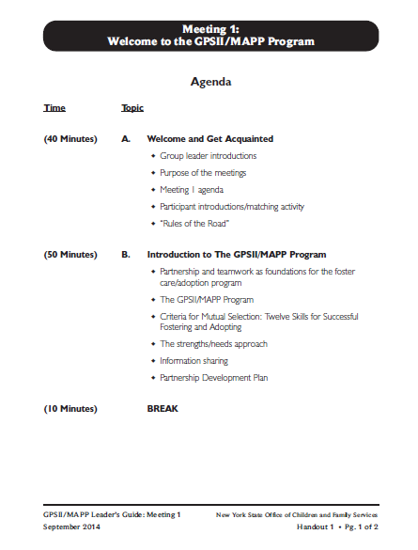

Slide 8
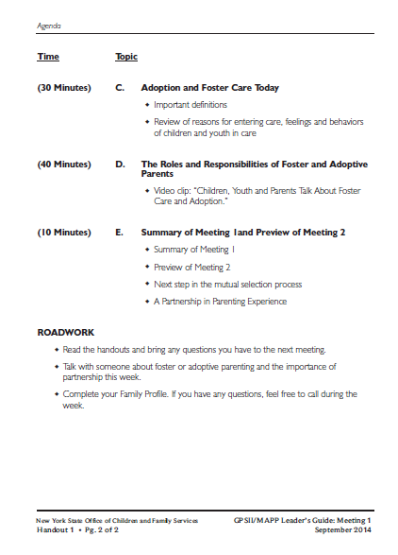

Slide 9
Introduce Yourself
1. My name is…
2. I live in…
3. I am here because…

Slide 10
Rules of the Road

Slide 11
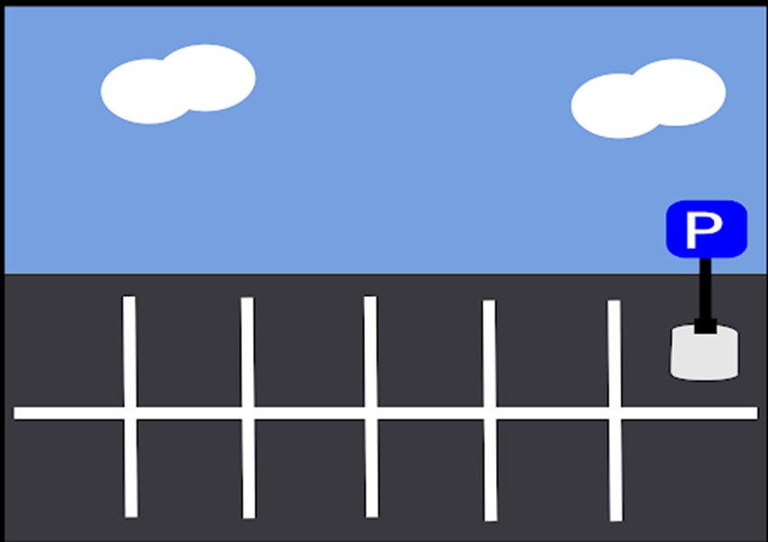
Parking Lot

Slide 12
What is GPSII/MAPP?
Group Preparation and Selection II
Model Approach to Partnerships in Parenting

Slide 13
Your leaders = Your tour guides

Slide 14
What is a successful team
you have been part of?

Slide 15
What is one quality that made
your team successful?

Slide 16
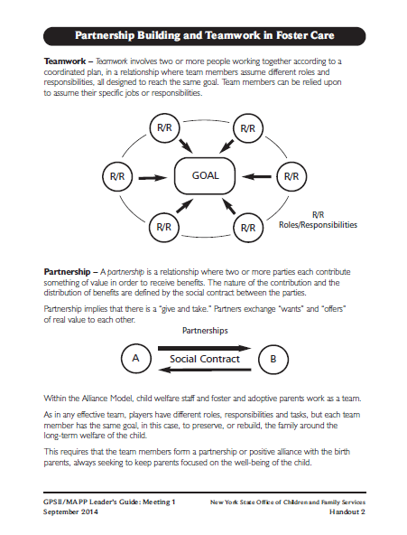
Let’s look at: Handout 2 “Partnership Building and Teamwork in Foster Care”

Slide 17
Who will volunteer?
Have a teenager living in your home
Be able to briefly describe your teenager
Imagine the teenager needing foster care (with the group’s help)

Slide 18
How much time would you want to spend with us before you were able to know all of us well enough to decide which one would make the best parent for your child?

Slide 19
What kinds of information would you want to have about each of us?

Slide 20
What skills would you want
us to have?

Slide 21
Preparation and Selection
Preparation for the Role | Preparation for the Decision
Selection by the Agency | Selection by the Family

Slide 22
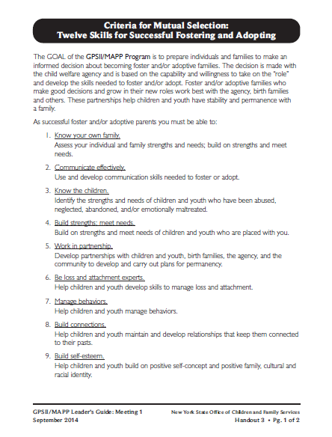
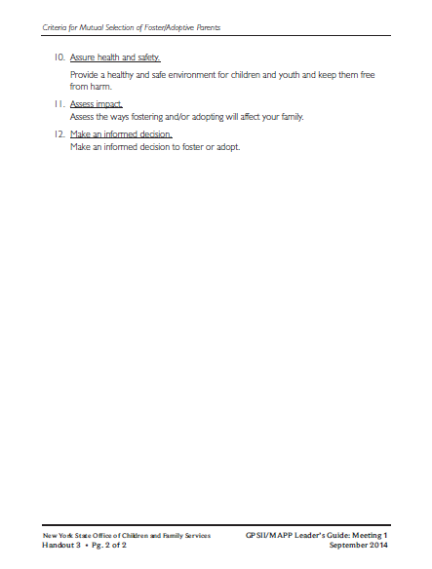
Let’s look at: Handout 3 “Criteria for Mutual Selection: Twelve Skills for Successful Fostering and Adopting”

Slide 23
Twelve Skills for Successful Fostering and Adopting
Know your family
Communicate Effectively
Know the children
Build strengths, meet needs
Work in partnership
Be loss and attachment experts
Manage behaviors
Build connections
Build self-esteem
10. Assure health and safety
Assess impact
Make an informed decision

Slide 24
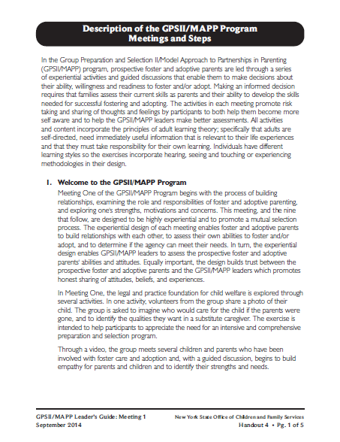
Roadwork Reading:
Read Handout 4, “Description of the GPSII/MAPP Program” Meetings and Steps”

Slide 25
Let’s look at: Handout 5

Slide 26
Strengths/Needs
Vs.
Strengths/Weaknesses

Slide 27
Let’s look at : Handout 6

Slide 28
Robert’s Weaknesses | Robert’s Needs | Robert’s Strengths

Slide 29
Strengths/Needs
Vs.
Strengths/Weaknesses

Slide 30
Ways Information is Shared in the GPSII/MAPP Program
Participation in meetings
Written materials
Family consultations
References

Slide 31
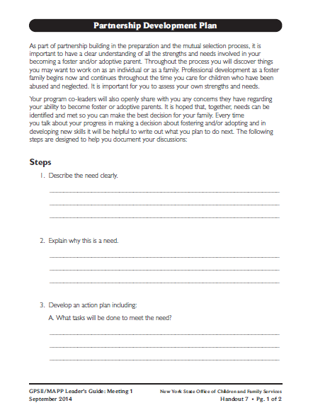
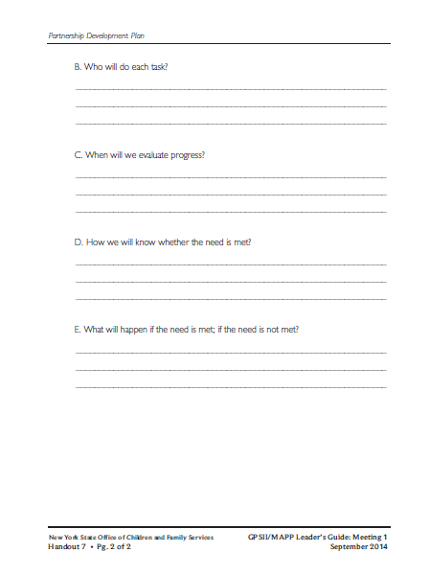
Roadwork Reading: Read but do not fill out Handout 7, “Partnership Development Plan”

Slide 32
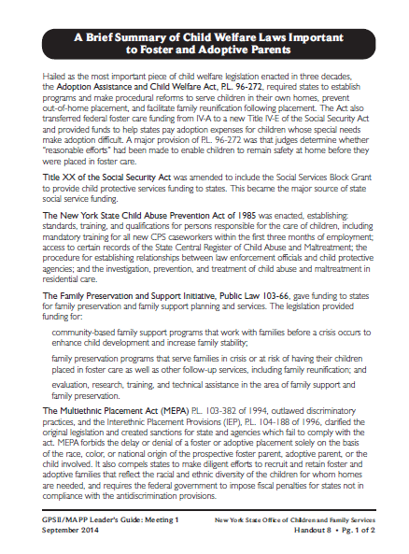
Roadwork Reading: Handout 8, “A Brief Summary of Child Welfare Laws Important to Foster and Adoptive Parents”

Slide 33
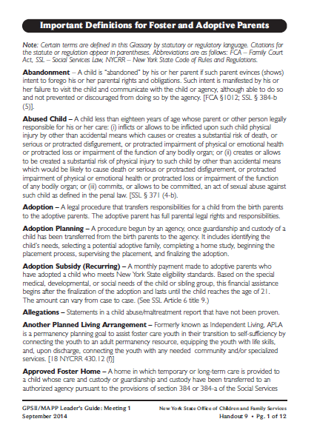
Roadwork Reading: Handout 9, “Important Definitions for Foster and Adoptive Parents”

Slide 34
Foster Care
Foster care of children means all activities and functions provided relative to the care of a child away from his or her home 24 hours per day in a foster family home or a duly certified or approved foster family boarding home
Adoption
A legal procedure that transfers responsibilities for a child from the birth parents to the adoptive parents. The adoptive parent has full parental legal rights and responsibilities.

Slide 35
Permanence
Permanence is the assurance of a family for a child intended to last a lifetime. Permanence assures a child of a family where he or she will be safe and nurtured. Foster parents work in teamwork with the caseworker and others to assure that a child returns to his or her home or has a timely plan for adoption or placement with extended family.
Concurrent Planning
Planning that works toward returning the child home while simultaneously developing an alternative plan for the child.

Slide 36
Reasons | Feelings | Behavior

Slide 37
Video:
Children, Youth, and Parents Talk About Foster Care and Adoption

Slide 38
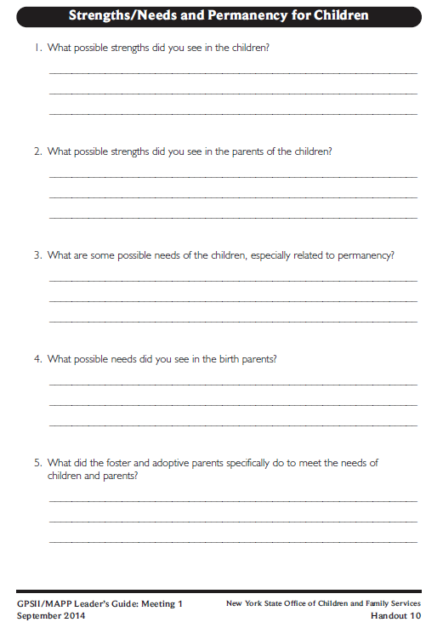
Let’s look at:
Handout 10

Slide 39
Twelve Skills for Successful Fostering and Adopting
Know your family
Communicate Effectively
Know the children
Build strengths, meet needs
Work in partnership
Be loss and attachment experts
Manage behaviors
Build connections
Build self-esteem
10. Assure health and safety
Assess impact
Make an informed decision

Slide 40
Roadwork
Read Meeting 1 handouts – bring questions to Meeting 2.
Talk about partnerships.
Complete your Family Profile. Call with any questions.

Slide 41
Children and Their Birth Families
Foster Children
Birth Parents

Slide 42
At the end of every meeting, we will share a PIP
Partnership
In
Parenting Experience
-Brief
-Positive
-Related to topics discussed

